Slide 1





Performance Effects of TLB Inclusion for Address Translation
By Christopher Brant, Quan Pham, and Nick Poindexter
T.L.B. : Team Let’s Ball

Slide 2

Introduction
A Translation Lookaside buffer is a hardware module that stores recent virtual address to physical address translations
TLBs are typically used to reduce the overhead related to accessing virtual memory and therefore increase performance
Since CPUs access virtual memory via both instruction fetch and loads/stores, there can be both instruction and data tlbs

Slide 3

Experiment Description
5 different TLB configurations:
No TLB for instructions nor for data
Instruction TLB and no data TLB
Data TLB and no instruction TLB
Both instruction TLB and data TLB
Both TLBs with full associativity and random replacement policy

Slide 4
Experiment Description
5 pre-compiled benchmark binary files:
fmath: floating point math
llong: long long math
lswlr: print ‘hello world’
math: integer math
printf: print extended output to terminal

Slide 5
Experiment Description
Simulate every combination of TLB configuration and binary file
Intentionally have high TLB miss latency to exaggerate consequences
Metrics of interest:
AMAT
TLB hit rate/utilization
CPI

Slide 6
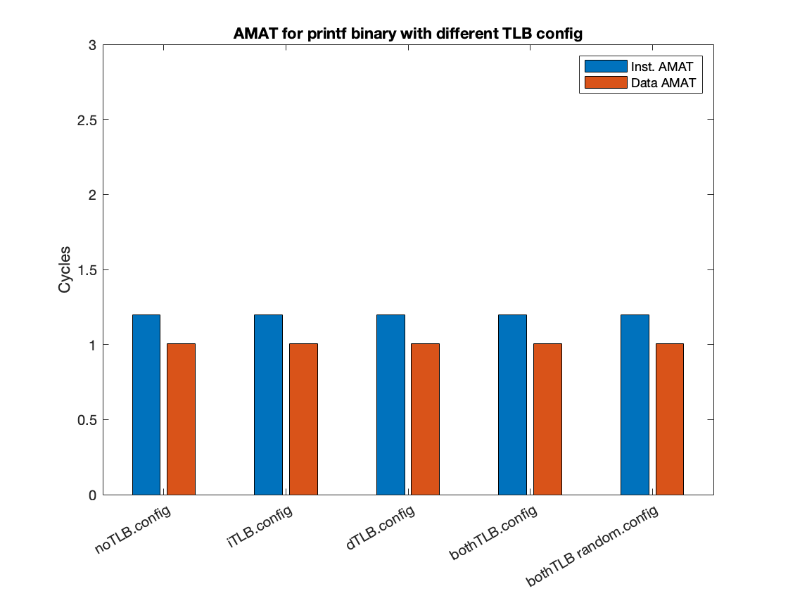

Metrics: AMAT
printf Binary File Used in the Above Test

Slide 7
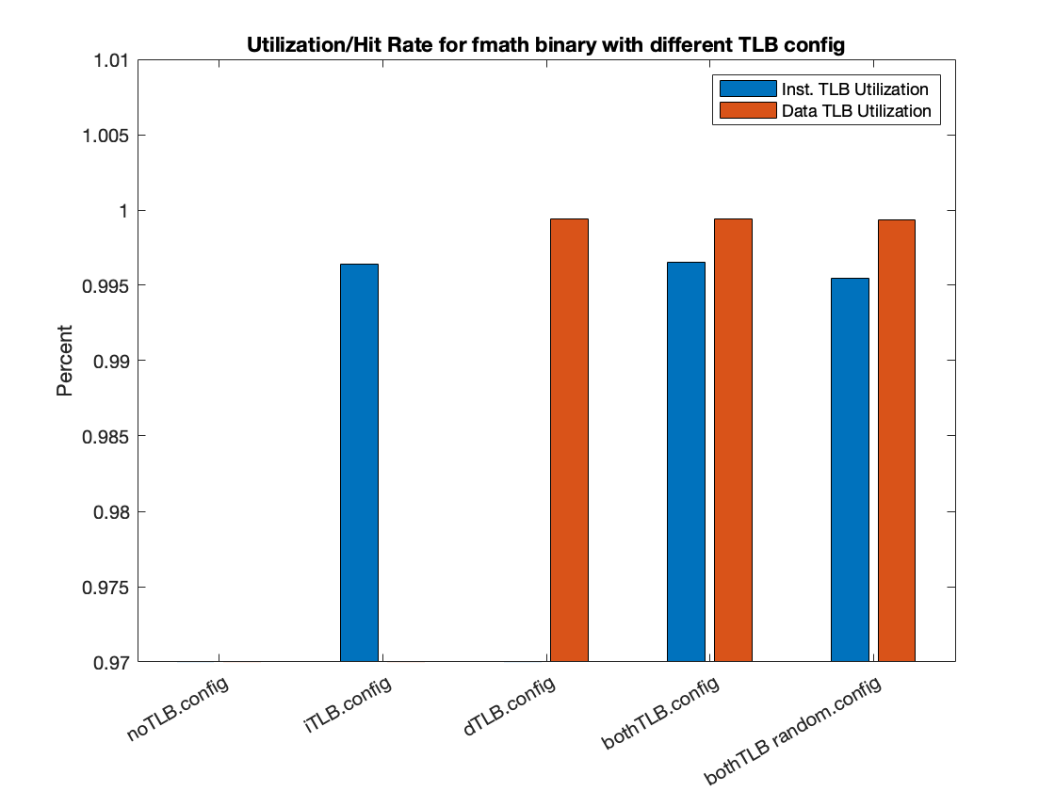
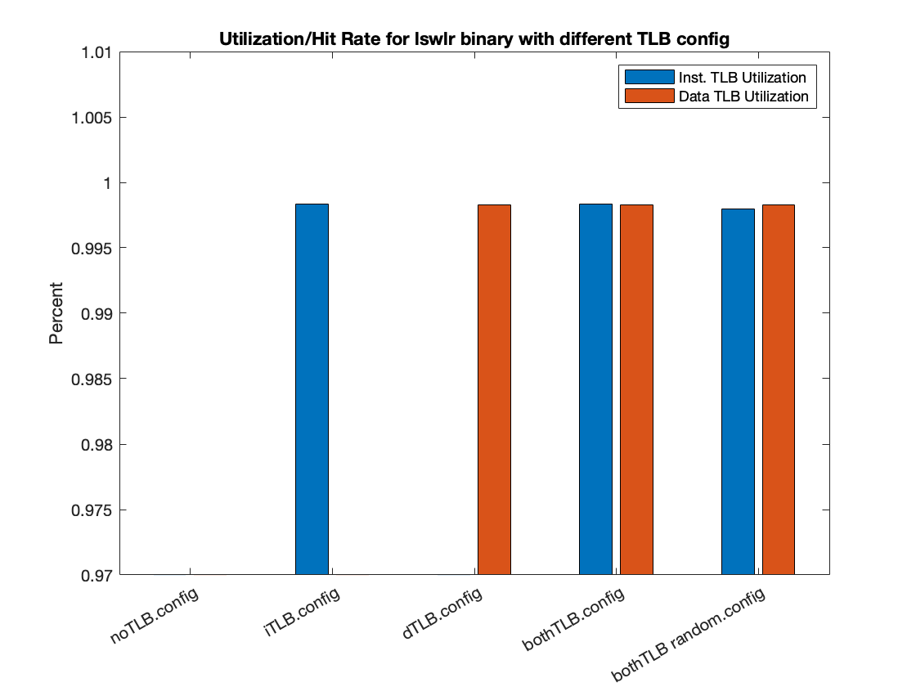

Metrics: TLB Hit Rate/Utilization
fmath Binary Test File
lswlr Binary Test File
printf Binary Test File

Slide 8
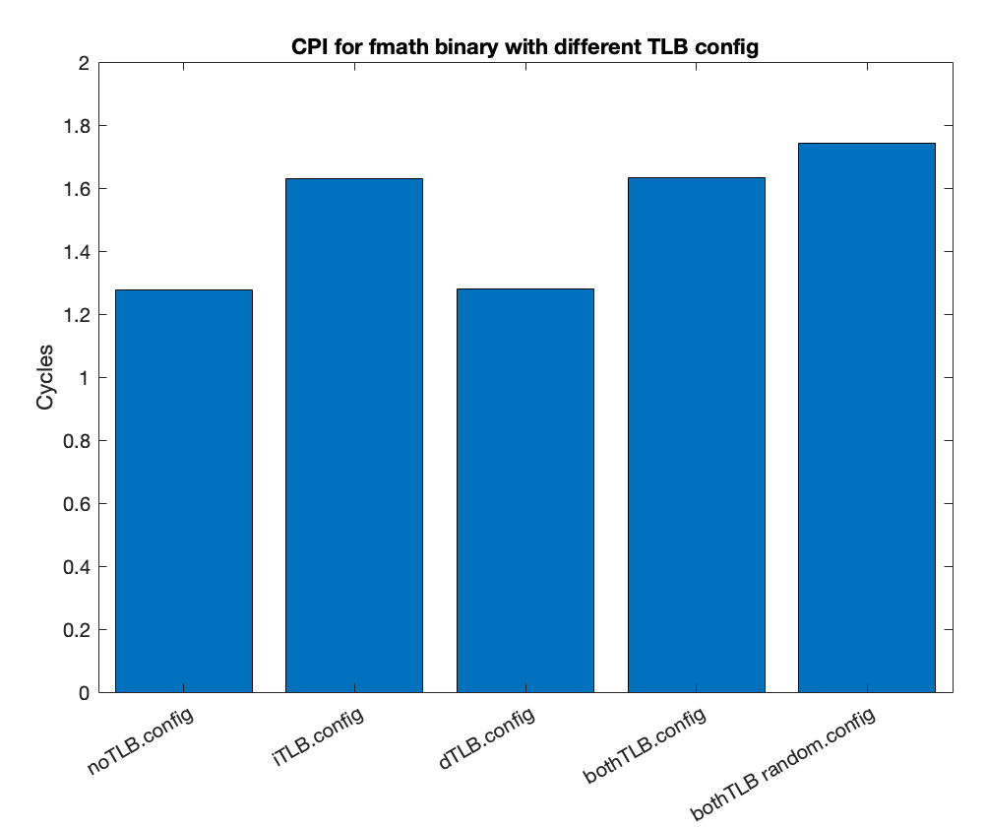
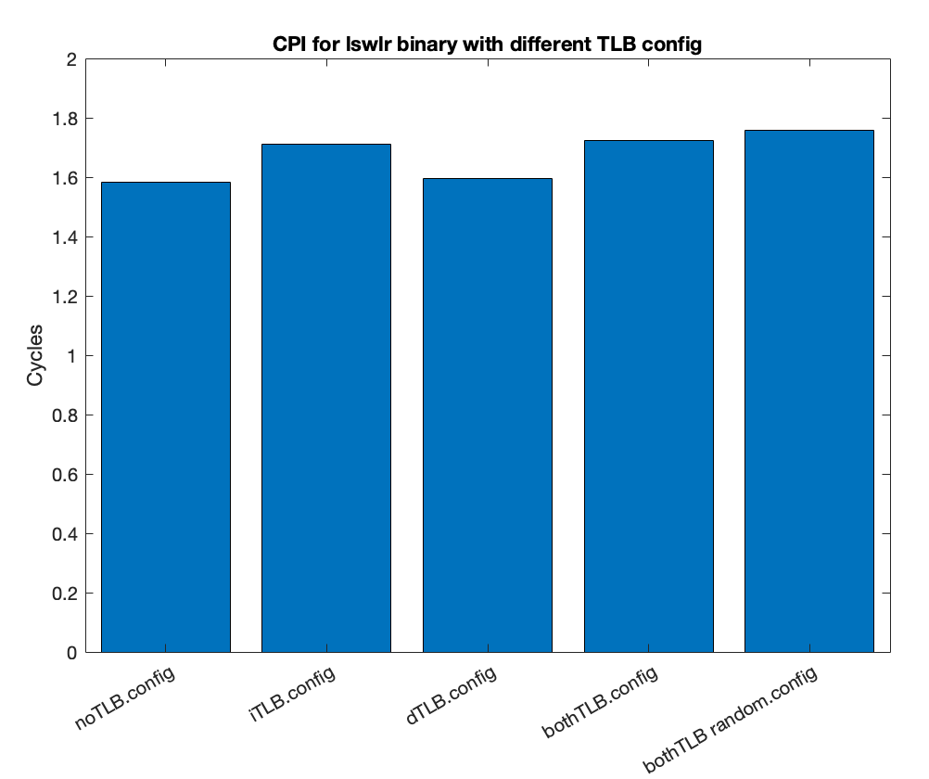
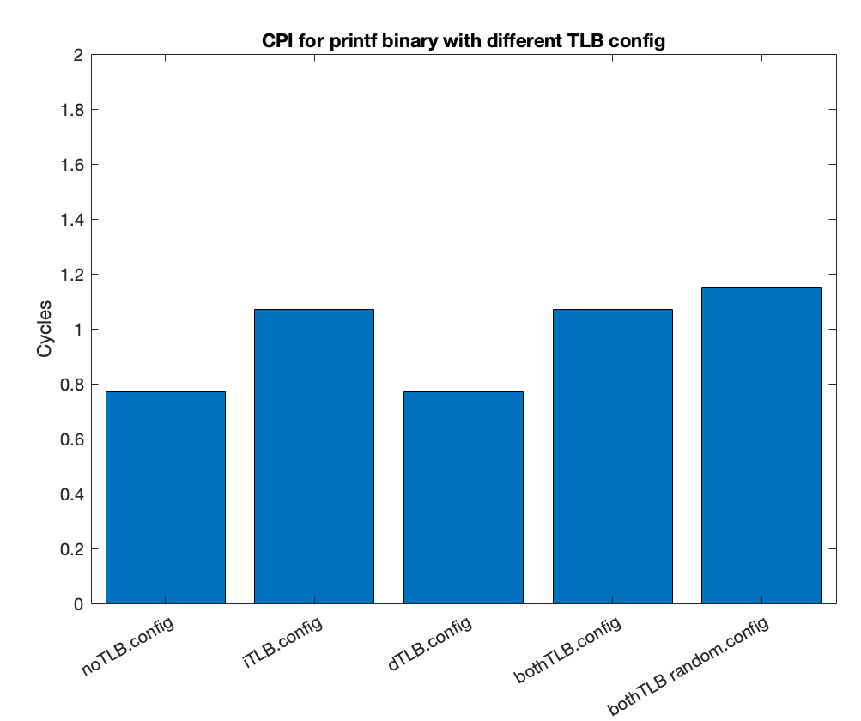
Metrics: CPI
fmath Binary Test File
lswlr Binary Test File
printf Binary Test File

Slide 9
Discussion of Results
Utilization
AMAT
CPI
High utilization is typical across test cases where TLBs are included.
More complexity of programs yield lower utilization/hit rate
AMAT will stay the same because the config of the caches is not changing
Variance of CPI is a result of the change in TLB hit rate and a high TLB miss latency.

Slide 10








>99%
Hit rate of every TLB configuration we tested in SimpleScalar.

Slide 11
Discussion of Results (cont.)
Including a TLB will increase the complexity of the design but will also decrease CPI and AMAT
As seen in our CPI results slide, it can be observed that the CPI increases in the case that the TLB replacement policy is changed from LRU to random.
The changes in results between the different TLB configurations with regards to performance in the metrics that we recorded was relatively small, even when we changed the associativity and replacement policy for our final configuration.

Slide 12
Conclusions
It can be concluded that introducing a TLB for fast memory address translation does have an impact on system performance, as our results were able illustrate with our high TLB miss latency. If that latency were to be reduced we would expect that performance would be better than not having a TLB at all.
Just as well, it can be concluded that changing the TLB replacement policy to be random replacement instead of LRU will reduce the performance of the overall system.

Slide 13
Future Work and Limitations
Prior to finishing our report we would like to run the same tests again, but with a much lower TLB miss latency than we have currently.
One thing we could have done differently is also run tests that contained more data accesses.
The reason we could not is that the cross compiler no longer could be compiled/installed correctly on our VMs, and therefore we were unable to compile our own programs for testing purposes.

Slide 14
Thanks for Watching!
Any questions?
Please contact us via email
quanpham@ufl.edu
cdbrant@ufl.edu
npoindexter@ufl.edu

